Slide 1

Introduction
PVFS2/OrangeFS is a popular opensource parallel file system specifically developed for highperformance computing
Originated from the Parallel Virtual File System , a project initiated at Clemson University and Argonne National Laboratory in the 1990s
This file system is renowned for its scalability, tailored to handle largescale data sets while providing swift I/O operations

Slide 2
Objectives
Aim to gain a thorough understanding of the architecture of PVFS2/OrangeFS
Walk through the sequential steps for the installation and configuration of PVFS2/OrangeFS
Learn about the key concepts of benchmarking within the context of PVFS2/OrangeFS

Slide 3

Overview of PVFS2/OrangeFS
PVFS2/OrangeFS is extensively used in HPC clusters around the world
It is specifically optimized for sequential data access patterns
It offers compatibility with a wide range of hardware and network interconnects
It is also highly portable across diverse platforms

Slide 4
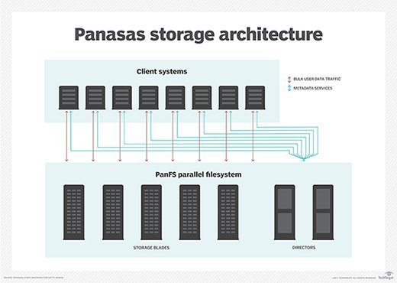
Parallel File Systems
Parallel file systems are crucial for breaking up and storing data in multiple locations for simultaneous access
PVFS2 plays a pivotal role in the realm of parallel file systems, known for its simplicity, robustness, and ability to scale in largescale environments

Slide 5

PVFS2/OrangeFS Architecture: Overview
PVFS2/OrangeFS utilizes a clientserver model where multiple clients can interact with multiple servers
It distinguishes data and metadata, each managed independently
This unique feature significantly contributes to its scalability

Slide 6
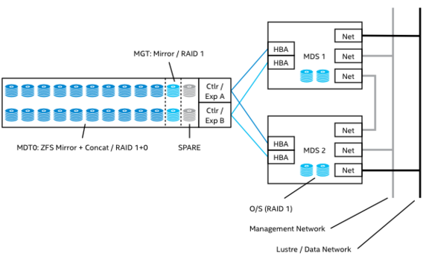
PVFS2/OrangeFS Architecture: Components
PVFS2/OrangeFS comprises three key components: Clients, metadata servers , and I/O servers
Clients serve as the interface between user applications and the file system
MDS and I/O servers are responsible for storing metadata and data objects, respectively
This Photo by Unknown author is licensed under CC BY-SA.

Slide 7

PVFS2/OrangeFS Architecture: Metadata
Metadata is crucial for data organization and retrieval in PVFS2/OrangeFS
It contains vital information like filenames, permissions, and data locations
Metadata is distributed across multiple servers, allowing the system to manage larger data sets while reducing metadata bottlenecks

Slide 8

PVFS2/OrangeFS Architecture: Data Distribution
PVFS2/OrangeFS employs data striping techniques, dividing data across multiple servers to enhance speed and reliability
RAID levels play a significant role in striking a balance between performance and reliability
This Photo by Unknown author is licensed under CC BY-SA.

Slide 9
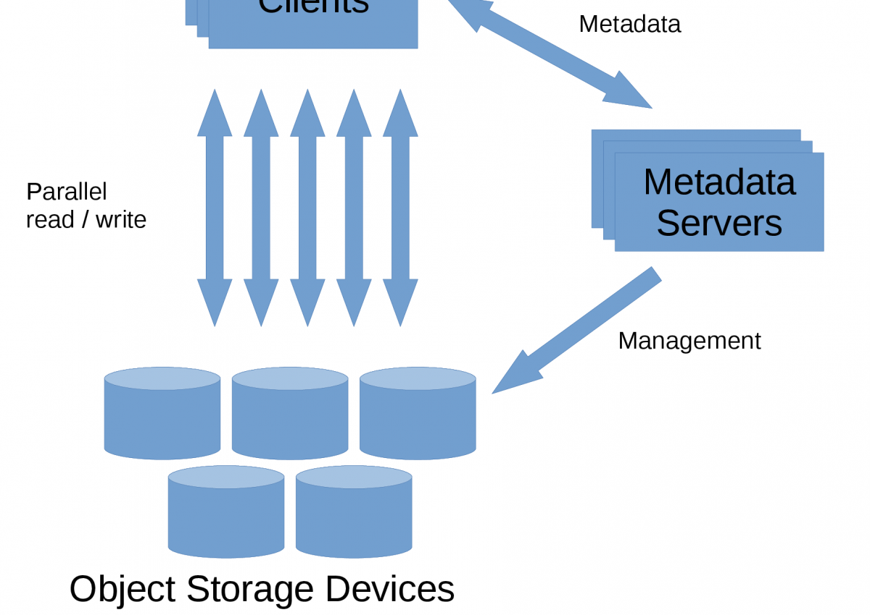
PVFS2/OrangeFS Architecture: Interactions
Clients interact with metadata servers for metadata operations and with I/O servers for data operations
Separating data and metadata operations helps maximize performance

Slide 10
PVFS2/OrangeFS Installation: Prerequisites
PVFS2/OrangeFS requires a Linuxbased operating system
It necessitates the presence of GNU development tools
Kernel compatibility and network interconnect compatibility with PVFS2/OrangeFS are also essential

Slide 11

PVFS2/OrangeFS Installation: Step 1
Begin by downloading the PVFS2/OrangeFS source code from the official website
Extract the source code using the tar command
Navigate to the directory containing the extracted source code

Slide 12
PVFS2/OrangeFS Installation: Step 2
Compile the source code using 'make' and 'make install' commands
Understand potential compilation flags and their impact on the build process

Slide 13
PVFS2/OrangeFS Installation: Step 3
Configure the file system using the PVFS2/OrangeFS configuration tool
Define file system specifications like the number of servers, their roles, and data and metadata distribution strategies

Slide 14
PVFS2/OrangeFS Installation: Step 4
Start the PVFS2/OrangeFS server using the 'PVFS2server' command and the client service
Understand various startup options and their implications

Slide 15
PVFS2/OrangeFS Installation: Verification
Check the status of the server and client using PVFS2/OrangeFS management commands
Perform simple file operations to verify the successful installation of the file system

Slide 16
PVFS2/OrangeFS Configuration: Overview
Configuration process involves defining servers, their roles, and setting up data and metadata distribution strategies
It is possible to reconfigure the file system without losing any data

Slide 17
PVFS2/OrangeFS Configuration: Step 1
Define the server hostnames or IP addresses

Slide 18
PVFS2/OrangeFS Configuration: Step 2
Define the data and metadata distribution strategies
Different RAID levels can be utilized depending on the use case

Slide 19
PVFS2/OrangeFS Configuration: Step 3
Save and exit the configuration file
Restart the PVFS2/OrangeFS servers for the changes to take effect

Slide 20
PVFS2/OrangeFS Configuration: Verification
Perform simple file operations to verify that the configuration changes were successful

Slide 21
PVFS2/OrangeFS Benchmarking: Importance
Benchmarking is essential for measuring the performance of PVFS2/OrangeFS under different workloads
It assists in identifying bottlenecks and optimizing the file system's performance

Slide 22
PVFS2/OrangeFS Benchmarking: Tools
Tools like IOR and mpiBench are available for benchmarking PVFS2/OrangeFS
These tools measure various metrics contributing to a comprehensive understanding of the file system's performance

Slide 23
PVFS2/OrangeFS Benchmarking: Procedures
Run the chosen benchmarking tool on the PVFS2/OrangeFS file system
Collect and interpret the results to understand the performance of the file system

